Slide 1
House of Perfumes
Ria Herwadkar
L39773396
Notes:
This presentation will go over my design choices for my perfume e-commerce website. I will be explaining how each section was designed for usability, branding and responsiveness.
I will be presenting my front-end development project for TNK Technologies . I have been tasked with designing and developing a fully responsive and accessible e-commerce website.

Slide 2

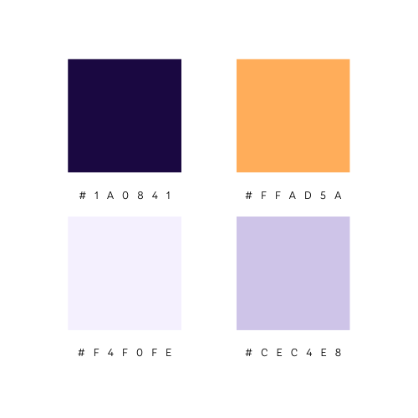

Introduction
Notes:
I will be presenting my front-end development project for TNK Technologies . I have been tasked with designing and developing a fully responsive and accessible e-commerce website.
House of Perfumes is a luxury fragrance brand and my aim was to create a visually appealing, accessible and user-friendly platform where customers can browse through and purchase perfumes seamlessly.
For the colour palette, I used a combination of a dark purple and golden yellow colour to create a sense of luxury. The website incorporates lighter purples for contrast and readability.

Slide 3
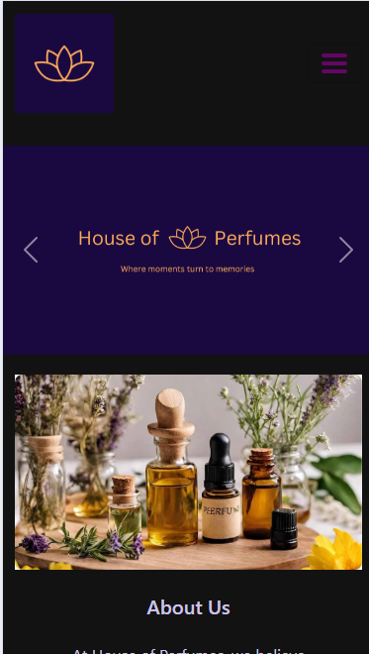
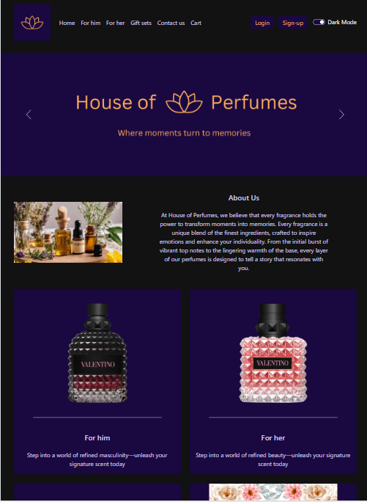

Home page
Notes:
This is the home page of the website. At the top, there is a menu that allows users to explore the website. On bigger screens, the menu is fully visible for quick access and on smaller screens. I have incorporated in a hamburger menu which will keep the layout interface tidy. By adding a dark mode toggle, I was able to enhance the readability in various light conditions while maintaining a sophisticated and visual appeal in both light and dark mode. The page the user is on highlights in a golden yellow colour which will help the users to identify their current page. A pink hover effect was also added to provide visual feedback for interactions. The home page includes a carousel which showcases the brand slogan and a brief introduction to the perfume collection. I used a carousel to create an engaging and dynamic experience. This allows users to see key brand elements without overwhelming the layout.
Below the carousel, the About Us section introduces users to the brands vision. The text is centered for readability along with an image of essential perfume ingredients for visual content. This section reinforces the brand’s identity while creating an immersive experience for visitors.
The menu cards provide users with a quick and visually engaging way to explore different section of the website. Each card represents a key category featuring fragrances, gift sets and easy access to customer support along with a clear message.
The footer provides quick access to necessary legal policies and the store location. The links highlight in a golden yellow when the user hovers over it for visual feedback. A location link is also available. This directs users to the store’s address for easy navigation.

Slide 4
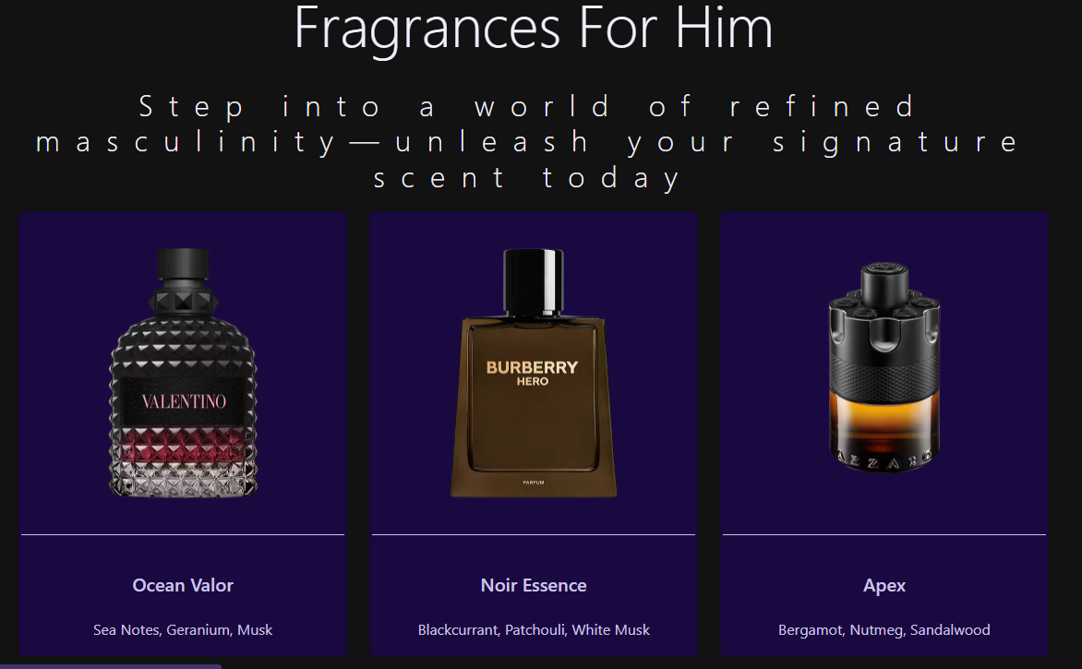
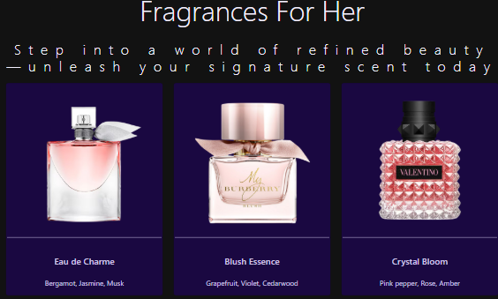
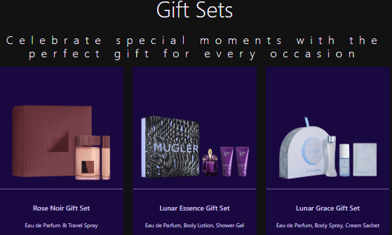
Product Listings
Notes:
The product listing pages for the For Him , For Her and Gift Sets pages all follow a consistent layout. This provides a seamless shopping experience. Each page features a heading and a subheading that introduces the fragrance collection, clearly defining the category while enhancing the brand’s high-end appeal to encourage users to explore through the perfume collection.
Each page displays nine products in a structured grid layout which ensures easy navigation across all categories. Each product card includes a high-quality image, product name and key fragrance notes for individual perfumes or the contents of the gift sets. This helps customers in making informed decisions by showcasing key information.
These pages also maintain the same navigation bar and footer as the home page, thus ensuring a familiar and cohesive browsing experience throughout the website.

Slide 5
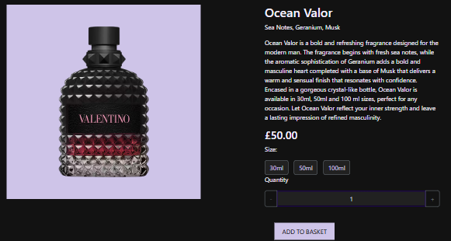
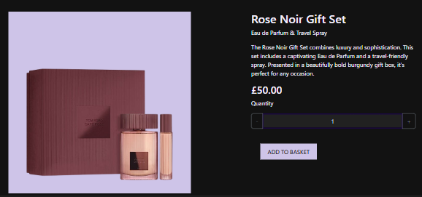
Product Individual Page
Notes:
The product individual pages provide detailed information about each product. This helps customers to make informed purchasing decisions. Each product individual page follows a consistent layout, featuring a high-quality image, product descriptions and pricing details. For individual perfumes, customers can select from three size options. This differs from the gift sets where it does not include a size selection but maintains the same structure.
There is a quantity selector which allows users to adjust their desired amount before adding the product to their basket.
The price dynamically updates based on the selected size and quantity, allowing users to view the total price before checkout.
The “Add to Basket” button allows for seamless cart updates. Once a product has been added to cart, a popup message appears with a confirmation text of how many items has been added to the basket. This allows for a smooth and intuitive shopping process.
The navigation bar and footer remain the same.

Slide 6
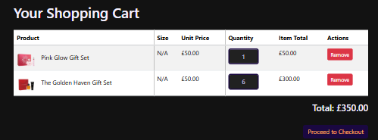
Cart
Notes:
The cart page provides users with a clear overview of their selected items, ensuring a smooth checkout process. It displays product images, names, sizes if applicable, unit prices, quantities and total costs in a structured table format. Users can adjust the quantity and the items total price updates dynamically to reflect the changes made.
The “Remove” button allows users to delete items from the cart. When an item is removed or the quantity is adjusted, the total price updates automatically.
This ensures a seamless and efficient shopping experience, allowing users to manage their cart with ease before proceeding to checkout.

Slide 7
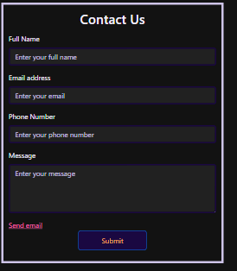
Contact Us Form
Minimalist Design: Keeps the form clean and easy to read.
Centered Layout: Draws focus to the form, making it the main point of interaction.
Soft Background Contrast: Ensures readability while maintaining aesthetics.
Clear Field Labels: Helps users understand where to input their details.
Consistent Button Styling: Matches the overall website design for visual cohesion.
Spacing Between Elements: Prevents a cluttered appearance and improves usability.
Notes:
The Contact Us Form follows a clean and straightforward design to enhance usability. The centered layout draws attention to the form. The soft background contrast enhances text visibility without straining the eyes. Well-labeled fields make filling out the form intuitive, and the styled submit button keeps branding consistent. Proper spacing between form elements improves the overall user experience by maintaining a neat and organized appearance.

Slide 8
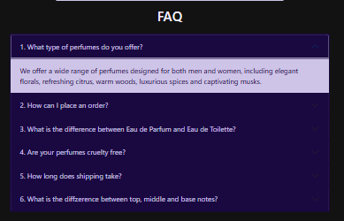
FAQ
Accordion Format: Keeps the page clean and organized by collapsing answers.
Expandable Questions: Allows users to access only the information they need.
Consistent Styling: Matches the rest of the website’s design for cohesion.
Centered Layout: Ensures a balanced and structured appearance.
Notes:
The FAQ section was designed using an accordion format to keep the page organized and clutter-free. Users can expand only the questions they need, making it easier to find relevant information. The consistent styling aligns with the website’s overall aesthetic, ensuring a seamless experience. A centered layout keeps the section structured, while dark mode compatibility enhances readability across different lighting conditions.

Slide 9
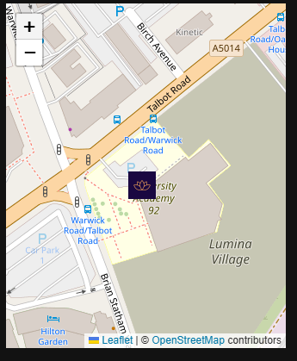
Interactive Map
Interactive Map: Allows users to zoom and move the map for better navigation.
Custom Marker: Highlights the store’s exact location for clear identification.
Minimalist Design: Keeps the focus on usability without unnecessary distractions.
Notes:
The map is fully interactive, allowing users to zoom and move for better navigation. A custom marker featuring the website’s logo highlights the store’s exact location, making it easy to identify. The design remains minimalist, keeping the focus on functionality.

Slide 10
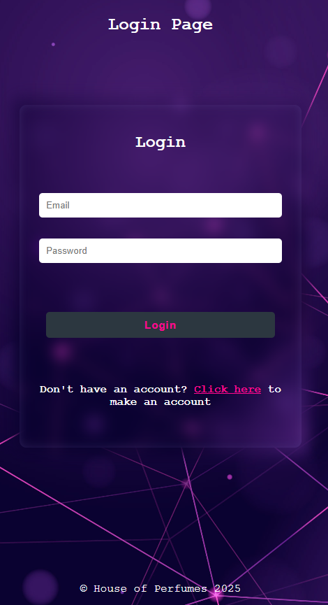
Login Form
Minimalist Layout: Keeps the focus on logging in.
Blurred Background Effect: Enhances readability while maintaining a modern aesthetic.
Centered Form: Ensures a structured and balanced look.
Protected Password: Improves security without affecting design clarity.
Small Footer: Reduces unnecessary elements to keep the design clean
Notes:
The login form was designed to be minimalist and user-friendly, ensuring users can log in without distractions. The blurred background effect keeps the form readable while maintaining a modern, sleek look. The form is centered, creating a structured and visually balanced layout. Having a protected password is included for security, but its design remains clear and non-intrusive. The small footer keeps the page clean, preventing unnecessary distractions from the login process.

Slide 11
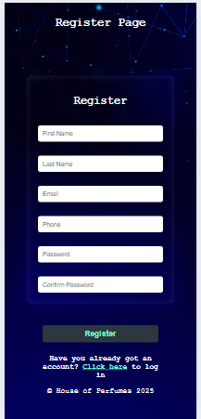
Register Form
Structured & Balanced Layout: Keeps fields organized for readability.
Blurred Background Effect: Improves focus on the form while maintaining aesthetics.
Consistent Input Field Styling: Creates a uniform and professional look.
Password & Confirm Password Fields: Ensures clarity in form completion.
Spacing Between Fields: Prevents clutter and enhances readability.
Minimal Footer: Maintains focus on the registration process.
Notes:
The register form was designed to be structured and easy to navigate, ensuring a smooth user experience. A blurred background effect was used to keep the form readable while maintaining an aesthetically pleasing design. Consistent input field styling ensures a professional and cohesive appearance. Password and confirm password fields are clearly separated, reducing confusion. Sufficient spacing between form elements prevents visual clutter, making the form easier to fill out. The minimal footer ensures the user's attention remains on completing their registration.

